Slide 1
Loops in Python
DVT101 – Lecture 9
- By Dataverse Tutorials

Slide 2
Introduction
What are loops in Python
Why repetition is important
Automation & efficiency
Loops in real life

Slide 3
Types of Loops
For Loop
While Loop
Nested Loop
Loop Control Statements

Slide 4
Internal Working of Loops
Iteration concept
Condition checking
Loop termination
Memory & execution flow

Slide 5
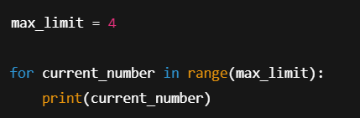
For Loop – Basic Example
Understanding for loop with range()
Loop start and stop behavior
How iteration works internally
Zero-based counting logic
When to use range-based loops

Slide 6
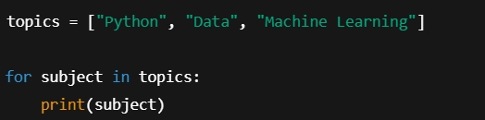
For Loop with Collections
Iterating over list elements
Element-wise loop execution
Data-driven looping
Real-world list processing
Cleaner than index-based loops

Slide 7
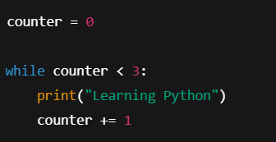
While Loop – Condition Based Loop
Condition-driven looping
Entry condition checking
Manual control of loop
Risk of infinite loops
When for loop is not suitable

Slide 8
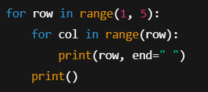
Nested Loops – Loop inside Loop
Outer vs Inner loop
Row-column logic
Pattern generation
Matrix-style execution
Data Science relevance

Slide 9
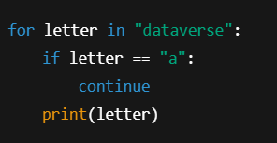
Loop Control Statements – break & continue
Altering loop flow
Skipping iterations
Early termination
Performance optimization
Conditional control

Slide 10
Real-World & Industry Use Cases
Data cleaning
Feature engineering
Automation scripts
ML training loops

Slide 11
Summary & Key Takeaways
For vs While
Nested loops
Control statements
Practice importance

Slide 12


